Slide 1


Data analysis for Geoscience
GEO8026
Dr. Seb Pitman

Slide 2


Course Introduction
Part 1: Data processing and analysis with MATLAB
Module delivered over two-weeks Consisting of five 7-hour blocks:
1-hour lecture, 2-hour practical, 3-hr guided independent study, 1-hour drop-in
Assessment: 1500-word portfolio
Part 2: Statistical methods and graphical techniques with R
Two-week long module consisting of 10hrs/week Assessment: 1500-word portfolio

Slide 3
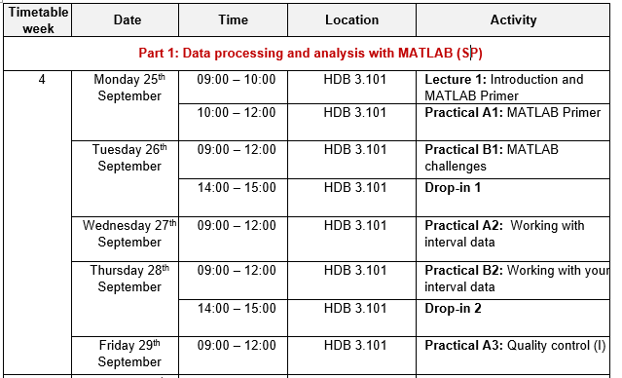
Part 1: Timetable

Slide 4
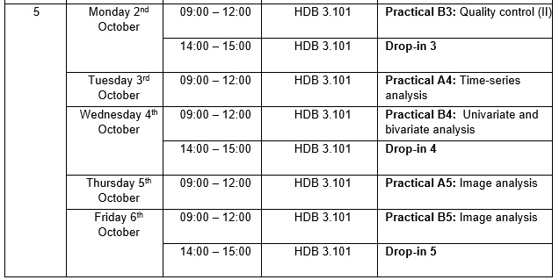
Part 1: Timetable

Slide 5










Characteristics of Geoscience Data

Slide 6

What are your topic(s) of interest?

Slide 7
What data are you planning on using?

Slide 8
What methods are you planning on using?

Slide 9


Code and data management
Generates a backup to the cloud which can be private or public (ensure private for this module)
Avoids having to keep track of multiple versions on your computer e.g. v1, …, v9, etc
All changes to the uploaded files (commits) can be viewed and changes are reversable
Good practice when working within a team environment
Ensure that your data is hosted online to ensure outputs can be reproduced
This should be publicly accessible to ensure the code completes properly
Needs to be shared during submission of portfolio

Slide 10
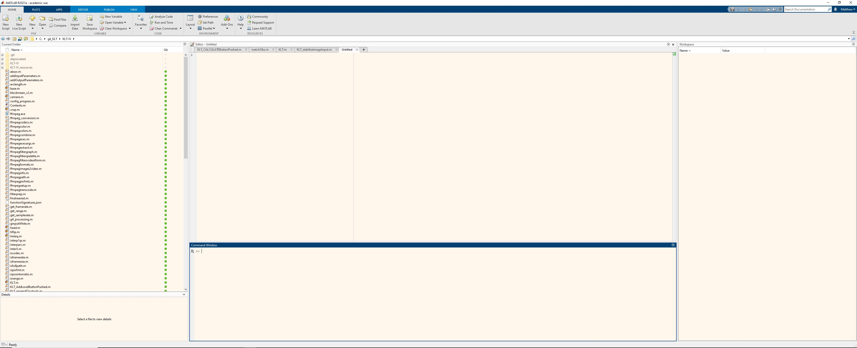
MATLAB primer
Current folder: Like windows explorer
i.e. shows files within the current directory
Editor: scripts, functions, and arrays can be edited
Workspace:
Array and variables are stored here
Command window: basic commands can be executed outside of a script (e.g. a = 1+1)

Slide 11
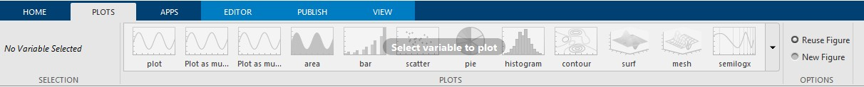
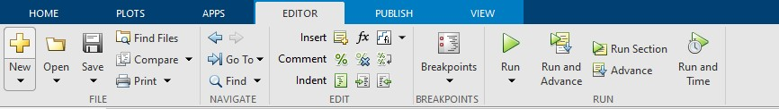
MATLAB primer

Slide 12
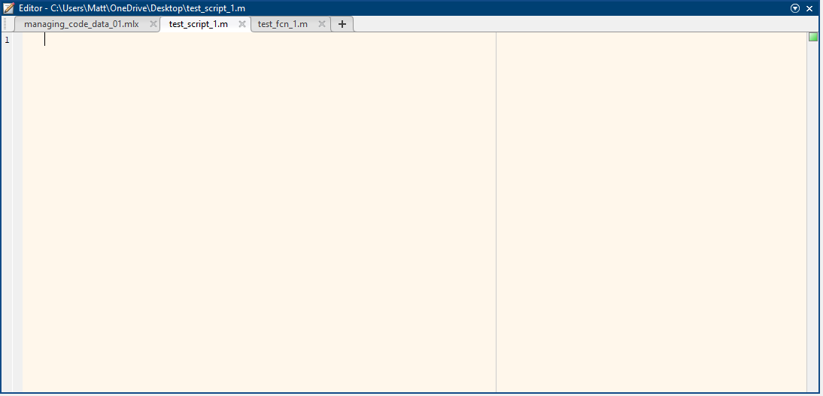
MATLAB primer
Scripts
Allow you to reuse sequences of commands by storing them in code files
A list of commands that are run from the current workspace.
All variables within the workspace can be called and all variables generated are stored in the workspace upon completion
An example command:
run 'test_script_1.m'
Can be called/run from the command window, or from other scripts/functions

Slide 13
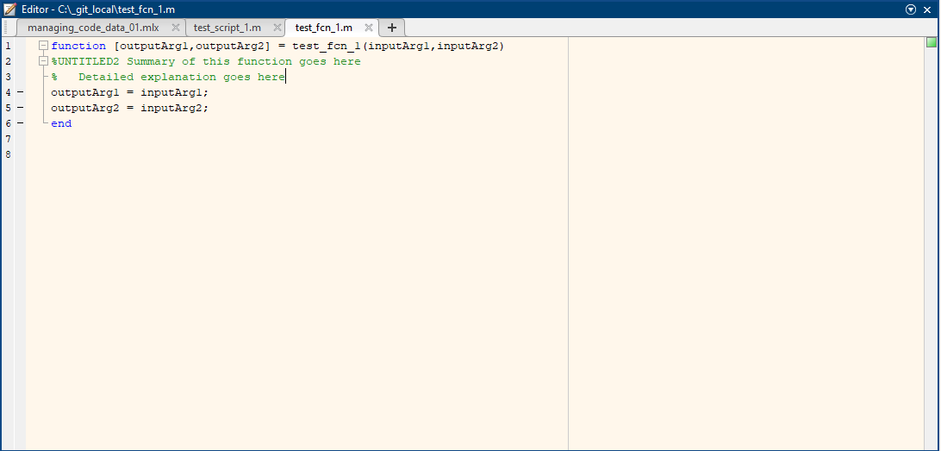
MATLAB primer
Functions
Allow you to reuse sequences of commands by storing them in code files
A list of commands that are run from the current workspace.
Only the variables defined as inputs are available within the function
Input an output argument naming conventions
Only the output variables are added
to the Workspace upon completion
An example command:
Can be called/run from the command window, or from other scripts/functions
[varOutA, varOutB] = test_fcn_1(varInA, varInB)

Slide 14

Interfacing with folders and directories
Over the course of this module, you will generate several scripts, functions, and use a range of datasets.
Organization of your files and folders is critical.
For MATLAB to call a script, function, or access a file, it needs to be visible on the ‘search path’.
To add files and folders to the search path, you can use the addpath function. E.g. :
addpath(genpath('C:\Users\Matt\OneDrive - Newcastle University\GEO8026’));
This will enable MATLAB to call and/or load files within this folder and all subfolders.
Your University OneDrive account is useful for storing your files (5 TB personal storage space)

Slide 15
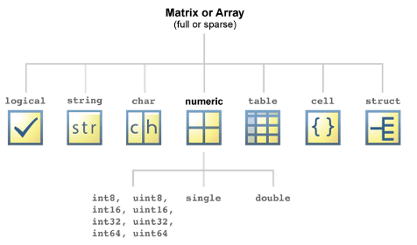
Data types
Logical = Boolean = 0 or 1, false or true
String = collection of characters (letters) Character = each letter is treated separately s = "apple"; f = s(1) % f = "apple"
c = 'apple'; f = c(1) % f = 'a'
Cell = Treated as non-numeric (but can be numeric)
c2 = {'apple', 0};
Numeric = only numbers (and NaN).
Double precision (default, 64 bits) most widely used Single precision (32 bits)
int8, int16, … = Variables with … bit signed integers uint8, … = Variables with … bit non-negative integers
Useful command:
whos
List the variables within the workspace and identifies the data type
Table = mixed input (numeric and string)
Structure = groups related data using data containers called fields

Slide 16
Logic & relation operations
Used to assess whether a command meets a requirement
~
NOT: Does not
AND: used to link expressions OR: used to link expressions
Short-circuit &: Used on two scalar expressions Short-circuit OR: Used on two scalar expressions
Logic
&
| &&
||
Used to assess whether a command meets a requirement
Relation
==
~=
<
<=
Equal to Not equal to Less than
Less than or equal to More than
More than or equal to
>
>=

Slide 17
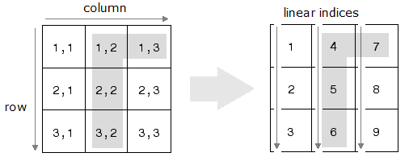
Array indexing
Matrix indexing A(1,2)
Linear indexing A(4)

Slide 18
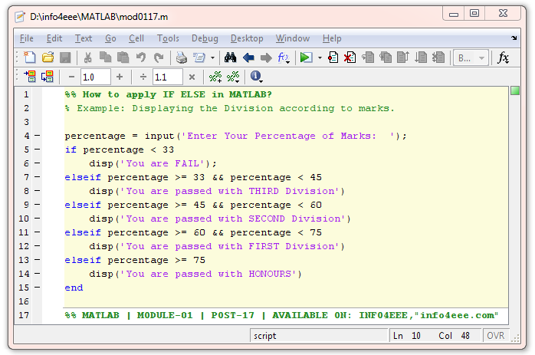
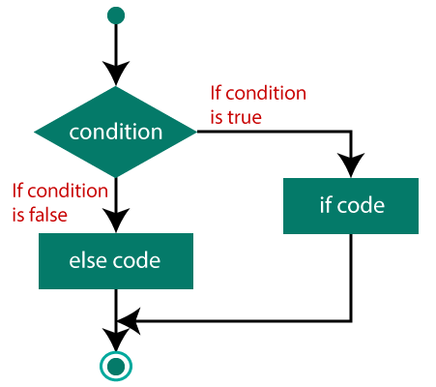
Condition statements

Slide 19
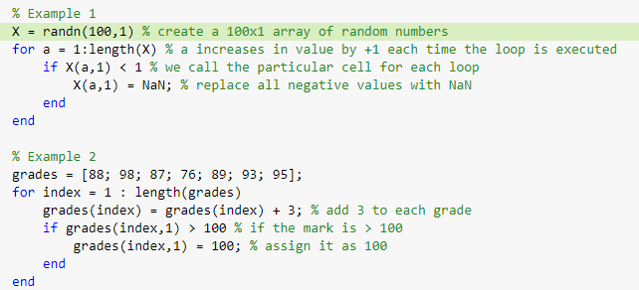
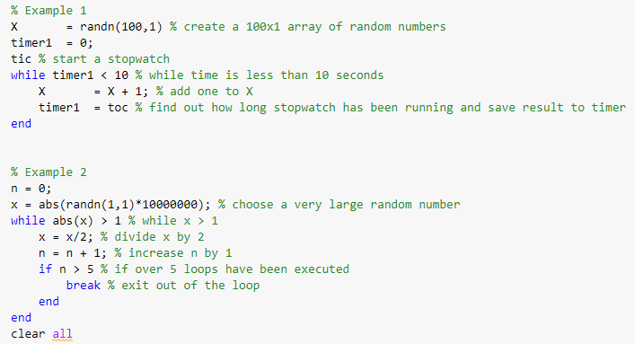
Loops (for and while)
For loop
While loop

Slide 20

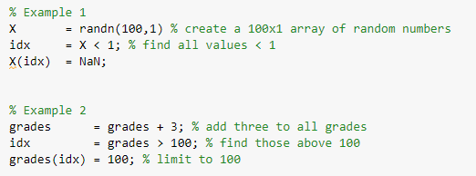
Vectorization
For loop
Cellfun
Advanced way of calling operations on each cell using anonymous functions
Vectorised version

Slide 21

Summary
Overview of the importance of source control
Introduction to the GUI of MATLAB
Interfacing with files and folders
Data types
Logic and relation operations
Array indexing
Condition statements
Loops and vectorisation

Slide 22
Next Session
Practical A1:
Themes:
01: Managing code and data 02: MATLAB primer
03: MATLAB challenges
Room: HDB 3.101
Time: 10:00 – 12:00

